Slide 1
Has the FED been able to fulfill the mandate given to it by Congress?
A Graphical Story By Umer Farooq

Slide 2
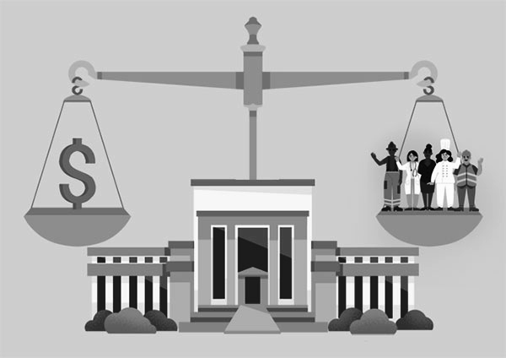
What is The Dual Mandate of FEDs:
Maximum employment
Price stability and affordable long term interest rate:
In order to carry out an analysis we will be looking at:
Unemployment Rate
The Consumer Price Index (CPI)
The FED Funds Rate
The Unemployment rate will be use to check the maximum employment mandate, similarly, CPI and FED Funds rate will be used to analyze the price stability and affordable long term interest rates.

Slide 3
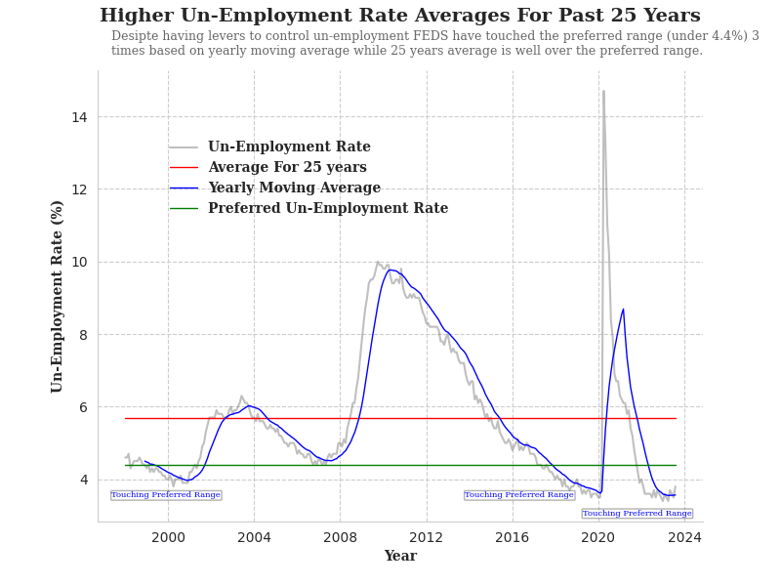
What Was The Average Unemployment Rate For Past 25 Years

Slide 4
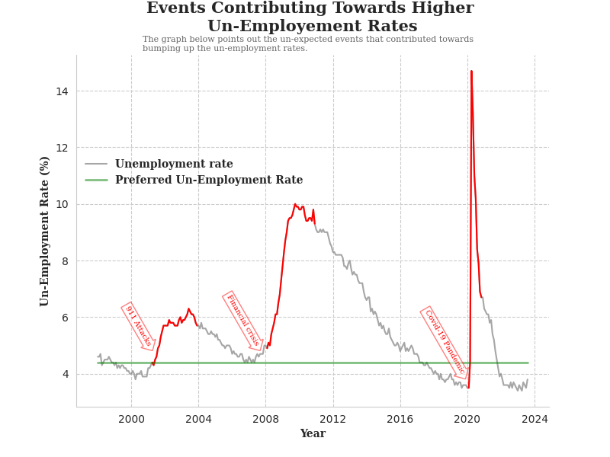
What Was Causing Higher Unemployment Rate ?

Slide 5
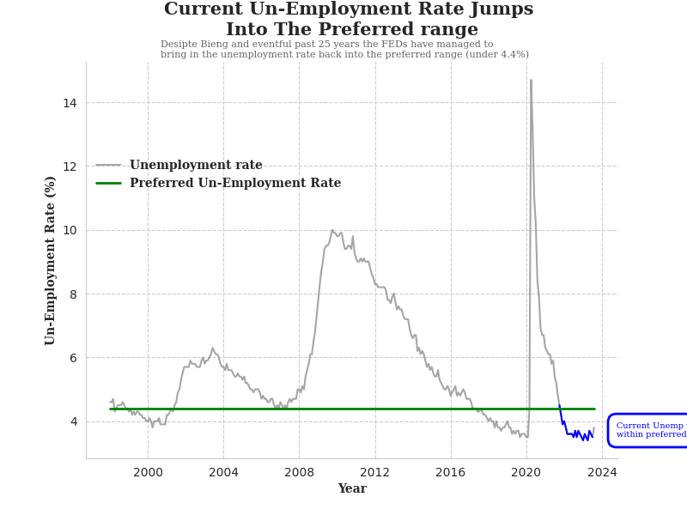
What is The Current Unemployment Rate ?

Slide 6
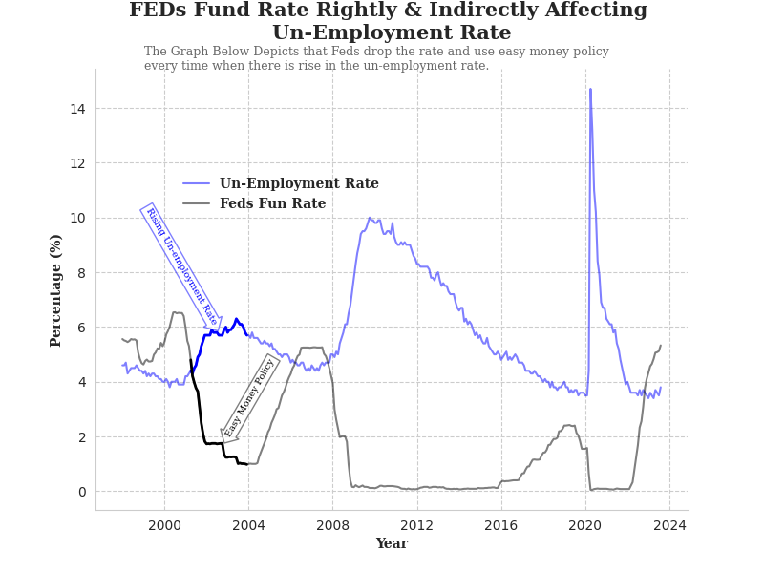
FEDs Action to Control Unemployment Rate ?

Slide 7
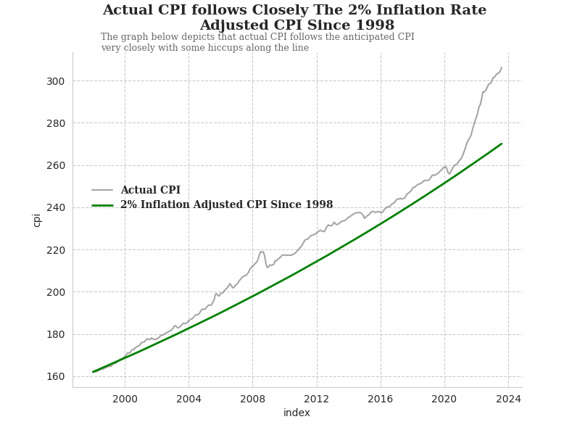
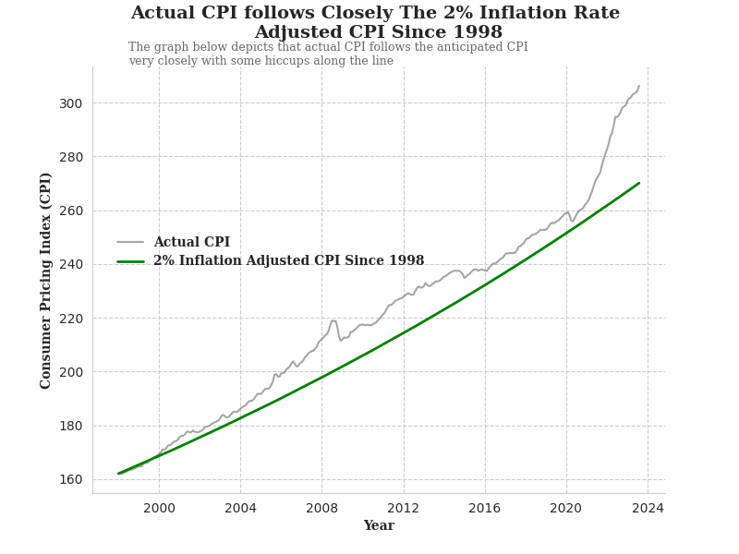
What Happened to Consumer Price Index (CPI)?

Slide 8
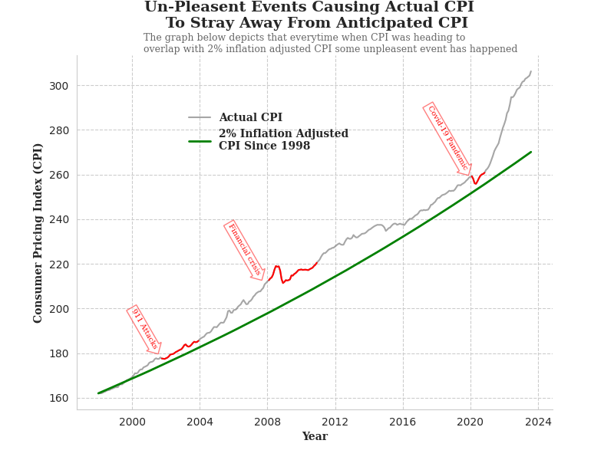
What Caused Actual CPI to Not Overlap on Anticipated CPI?

Slide 9
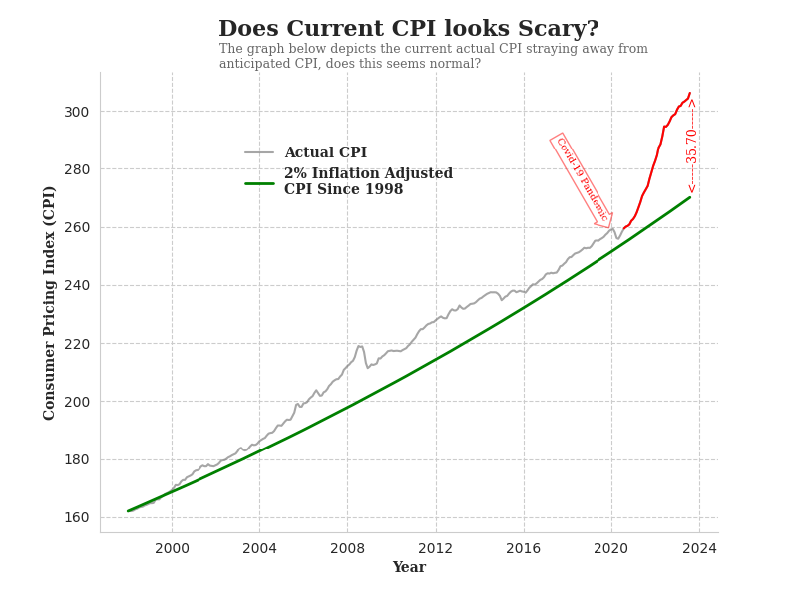
What About Current CPI?

Slide 10
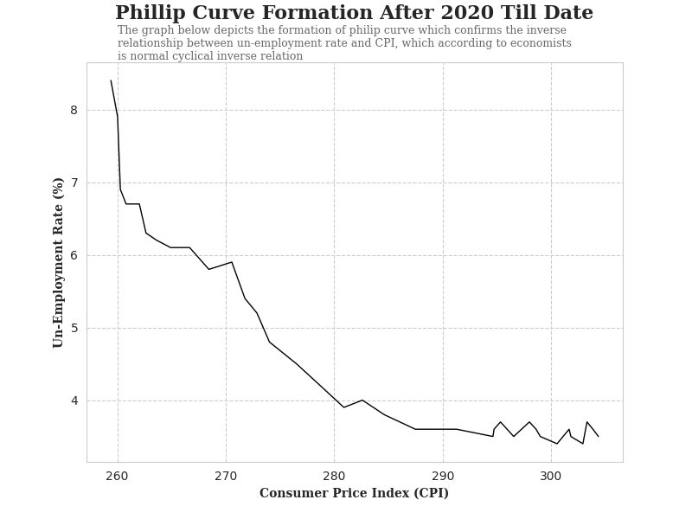
Current CPI is Normal According to Some Economist

Slide 11
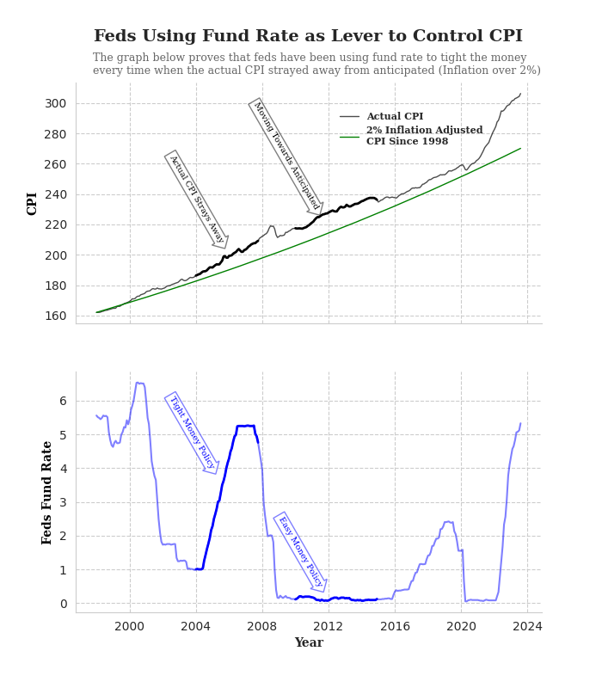
FEDs Action to Control CPI ?

Slide 12
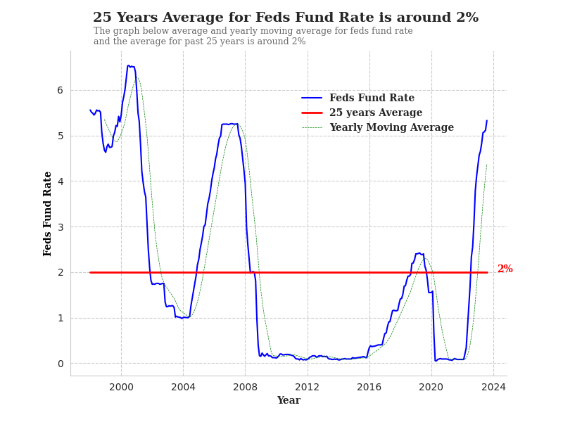
What Are The FED Fund Rate Averages For Past 25 years?

Slide 13
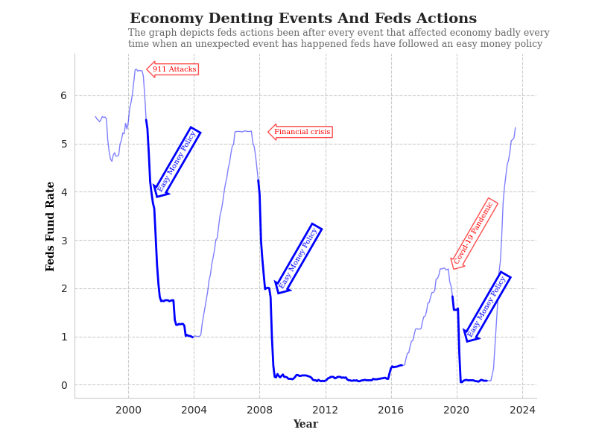
How Did FED Respond to Economy Denting Events?

Slide 14
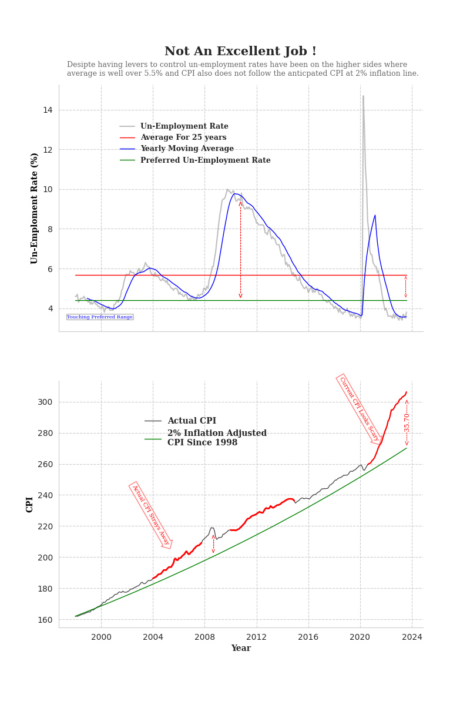
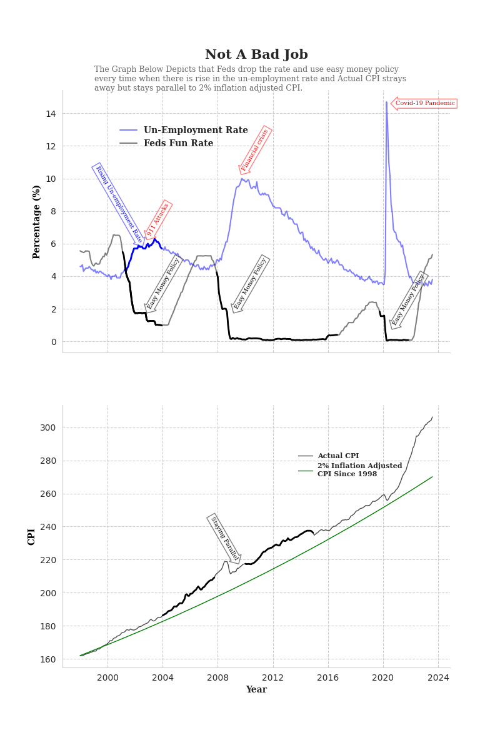
In Conclusion !

